Slide 1

An online SHOPPING website project
by group 2
Danna Pauline Soquiat
Kassandra Ysabel Fuentes
Lance jasper lopez
Meynard denoyo
William Kalingasan
Ziegfreid morissey flameÑo

Slide 2
Background
Watch Me Whip is an online watch shop that features:
Register/Login/Logout
Add/Edit/Remove Product From Cart
Save Cart Upon Logging Out
Mark Products As Favorites
View Product details and reviews
Post/Delete Review
Apply For Premium Account
Apply Premium Code Upon Registering
Update Customer Information
User Count
Admin Account
User, Product, Online User, Order Management (Admin)

Slide 3
Limitations
No validation if premium code is valid
No dedicated DB table for premium codes (only placed in config file)
No confirm password
Basic CRUD for order management
Order history for customers are not detailed

Slide 4
Distribution of Tasks
General Distribution:
Client-Side Development
Ziggy
William
Kass
Server-Side Development
Lance
Danna
Meynard
Testing
Lance

Slide 5
Distribution of Tasks
Detailed Distribution
Ziggy
Product Detail/Review Window (UI)
Product List/ Favorite Item List (UI)
Refresh Handling (UI)
UI Bug Fixes
Admin Background System Initial Design
General UI Design
William
CRUD for Online Users (UI)
CRUD for Orders (UI)
Browse product window
ERD

Slide 6
Distribution of Tasks
Lance
Product Review Table + CRUD (Backend)
Log File (Backend)
Testing
Meynard
Login Enhancement (Backend)
List of Online Users Controller (Backend)
Refresh Handling (UI)

Slide 7
Distribution of Tasks
Danna
Testing and CRUD Methods for User, Order, Products (Backend)
UML
Gantt Chart and PPT
Kass
CRUD for Users (UI)
CRUD for Products (UI)

Slide 8
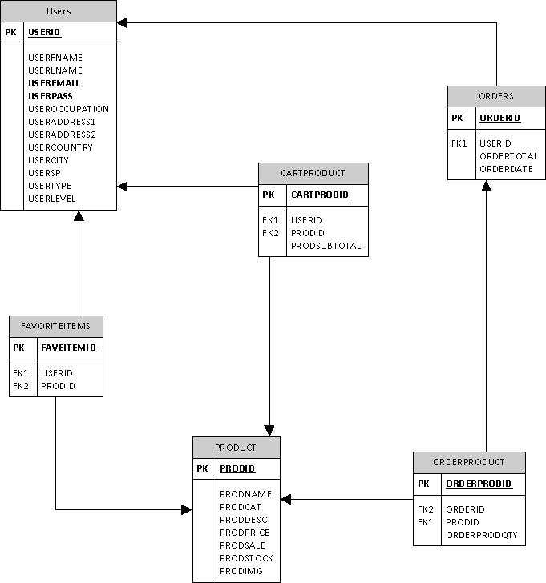
Entity Relationship Diagram
Ideal Diagram

Slide 9
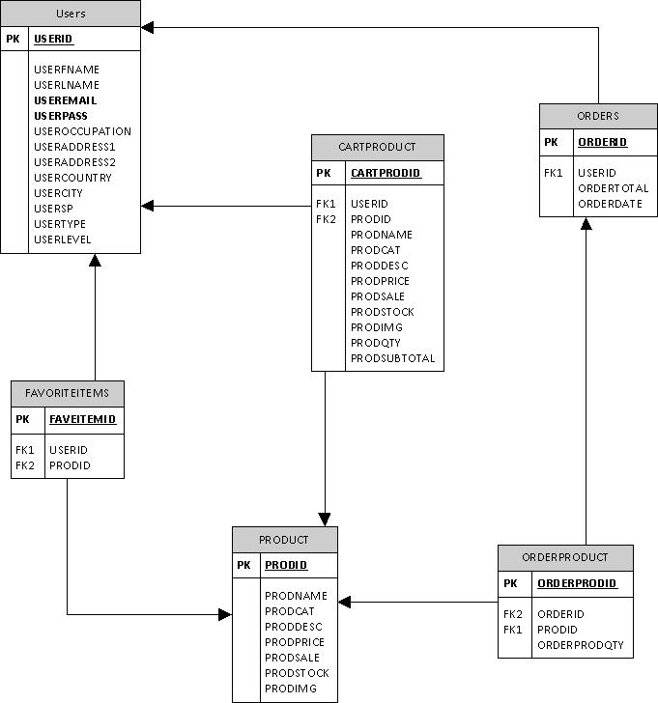
Entity Relationship Diagram
Actual Diagram

Slide 10
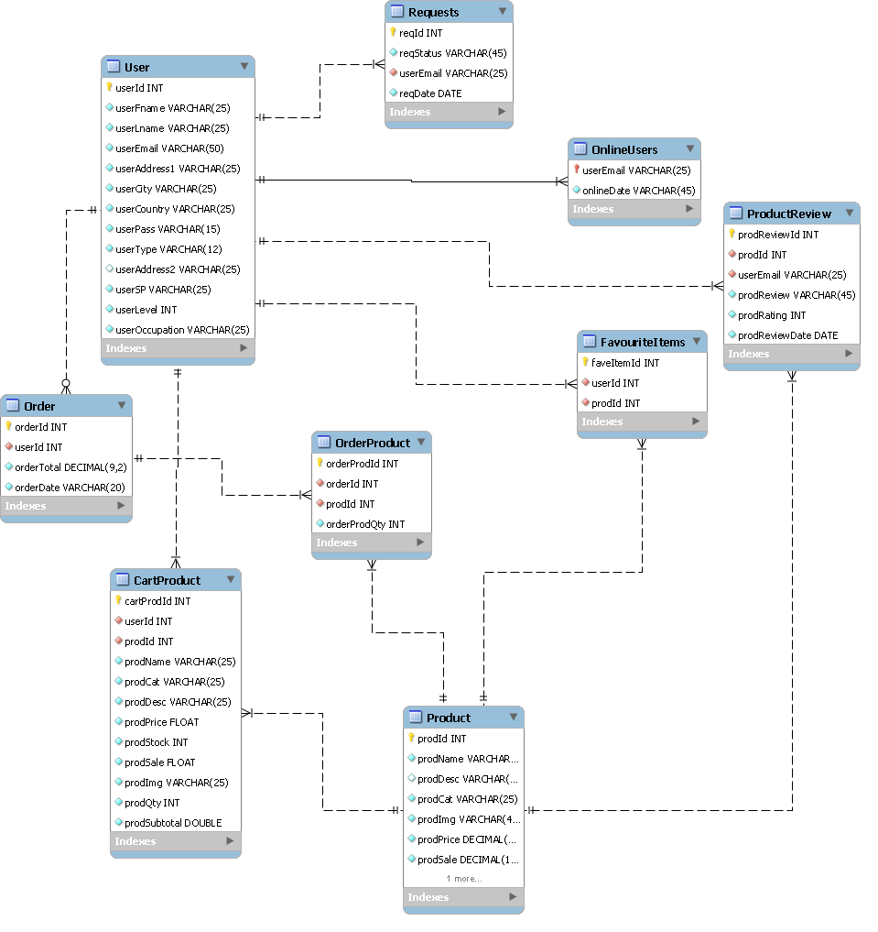
Entity Relationship Diagram
Final Diagram

Slide 11
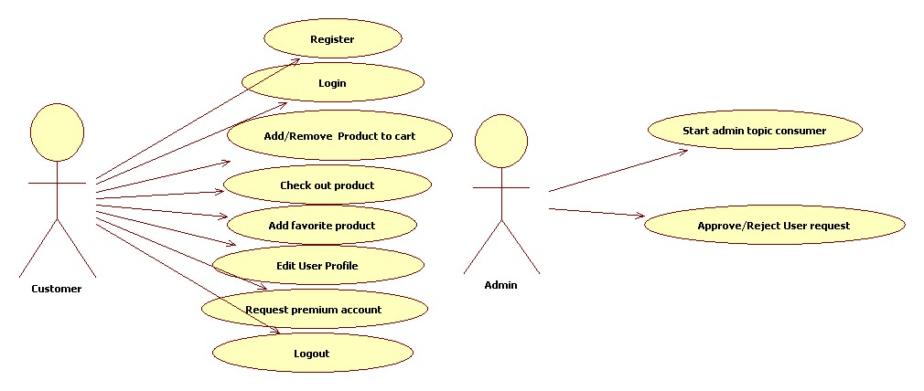
UML Diagram

Slide 12
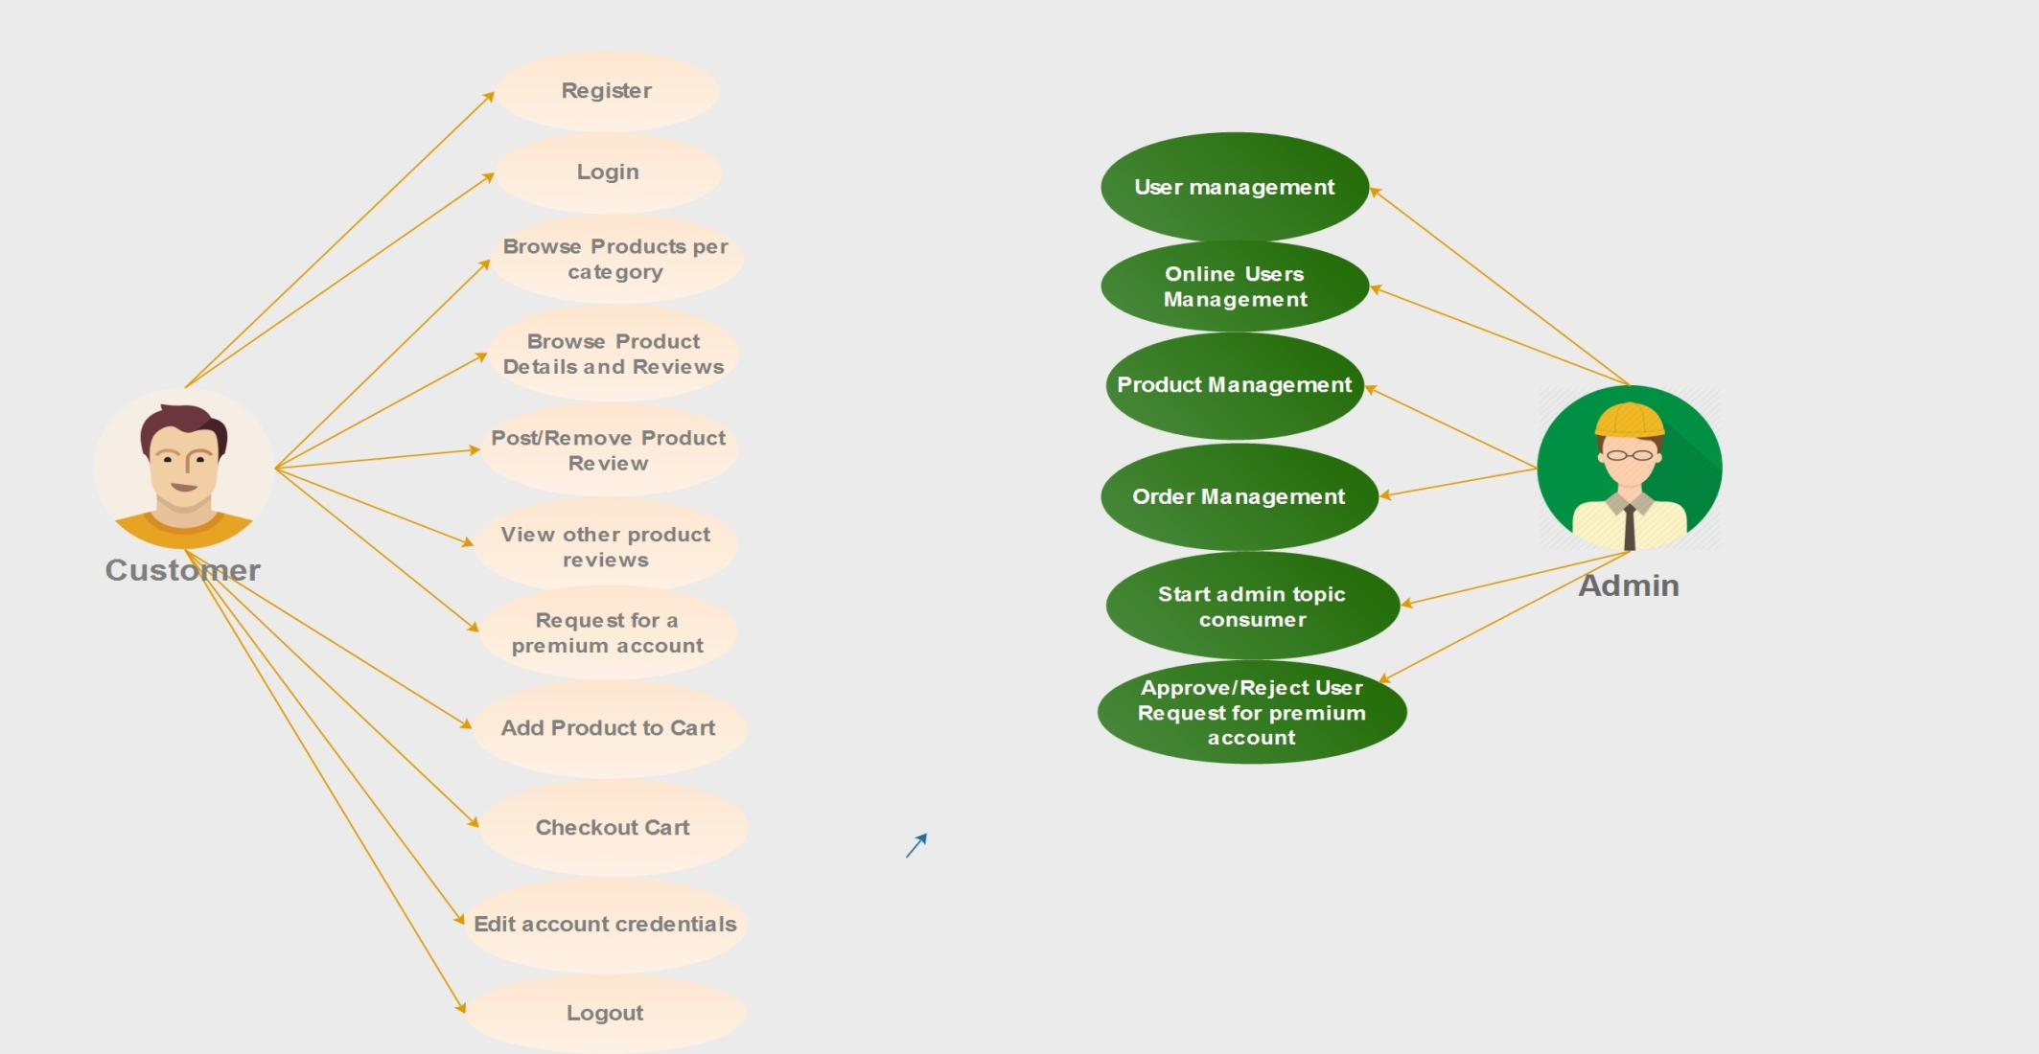
UML Diagram

Slide 13
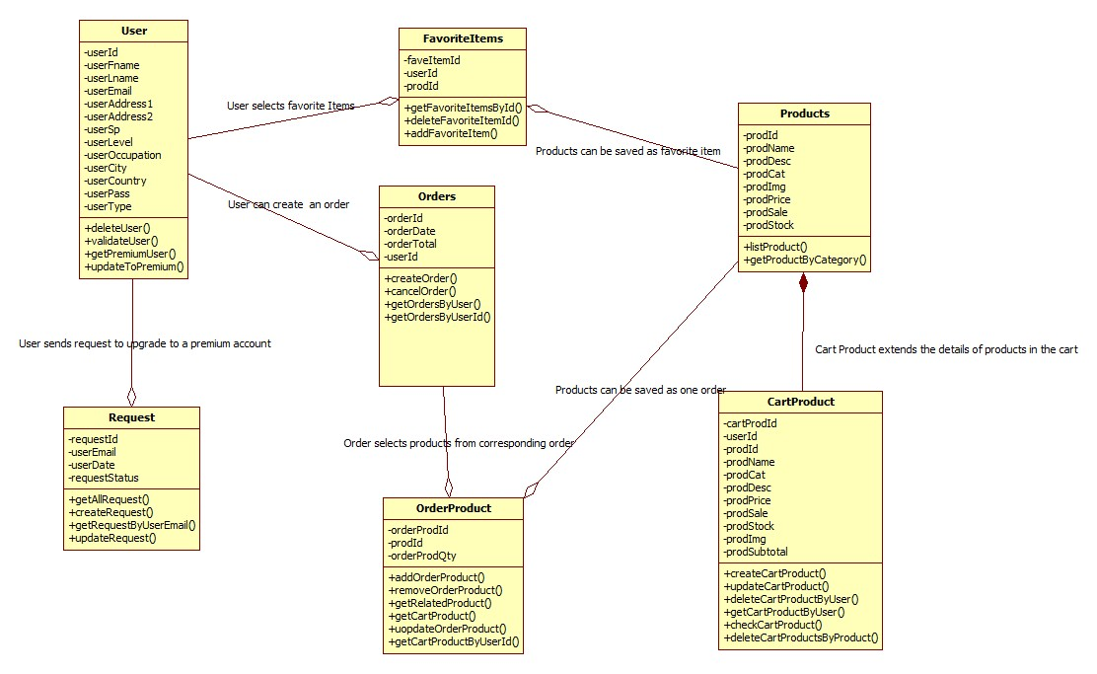
UML Diagram

Slide 14
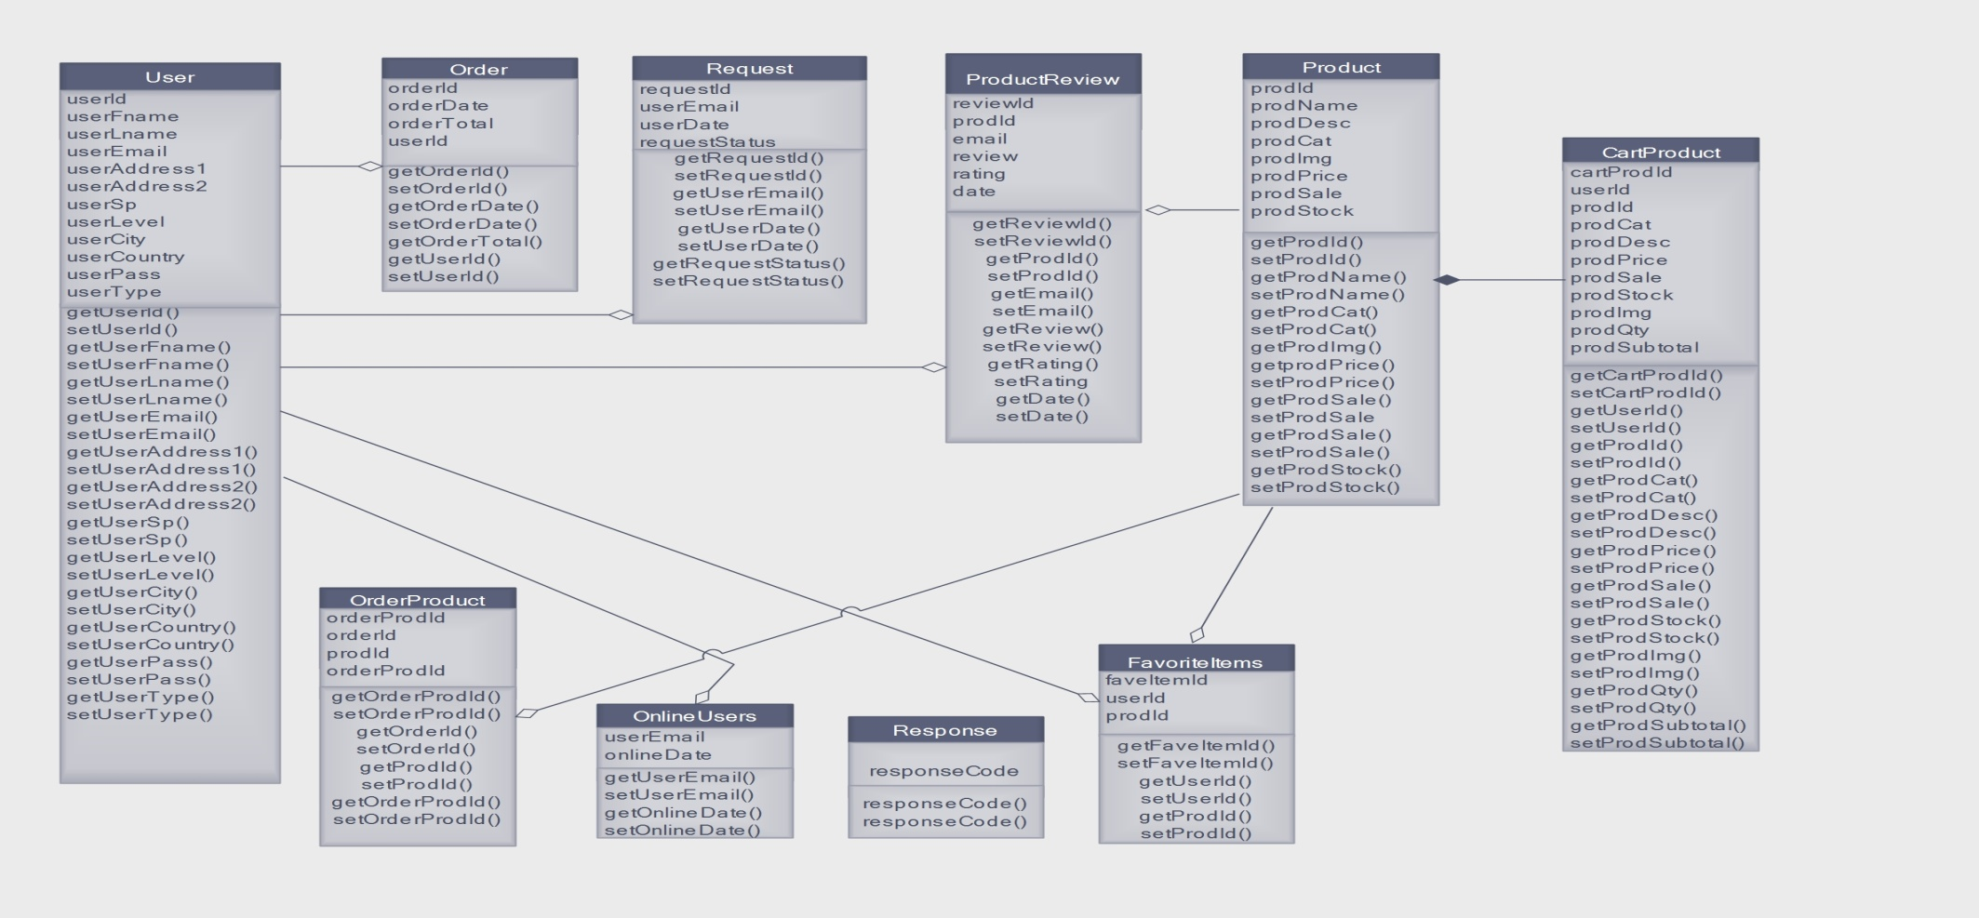
UML Diagram

Slide 15
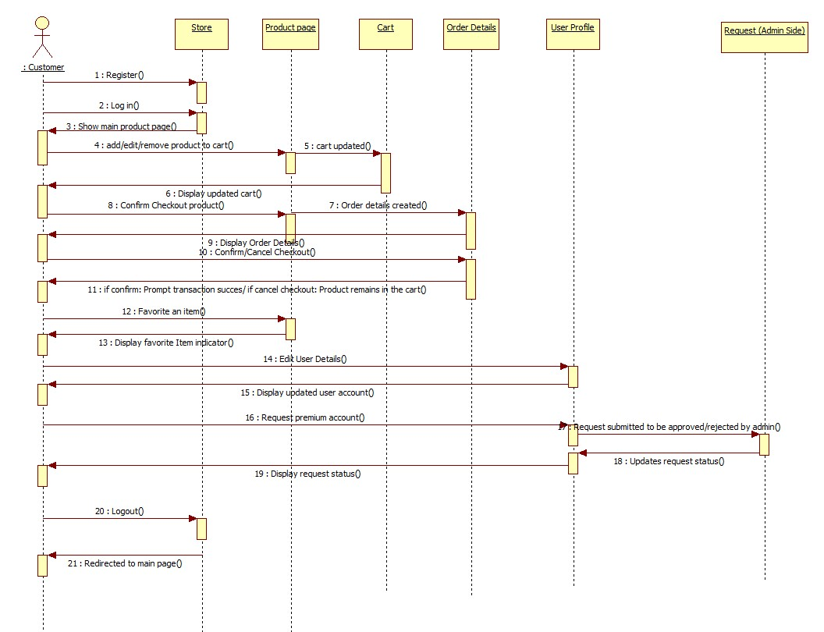
UML Diagram

Slide 16
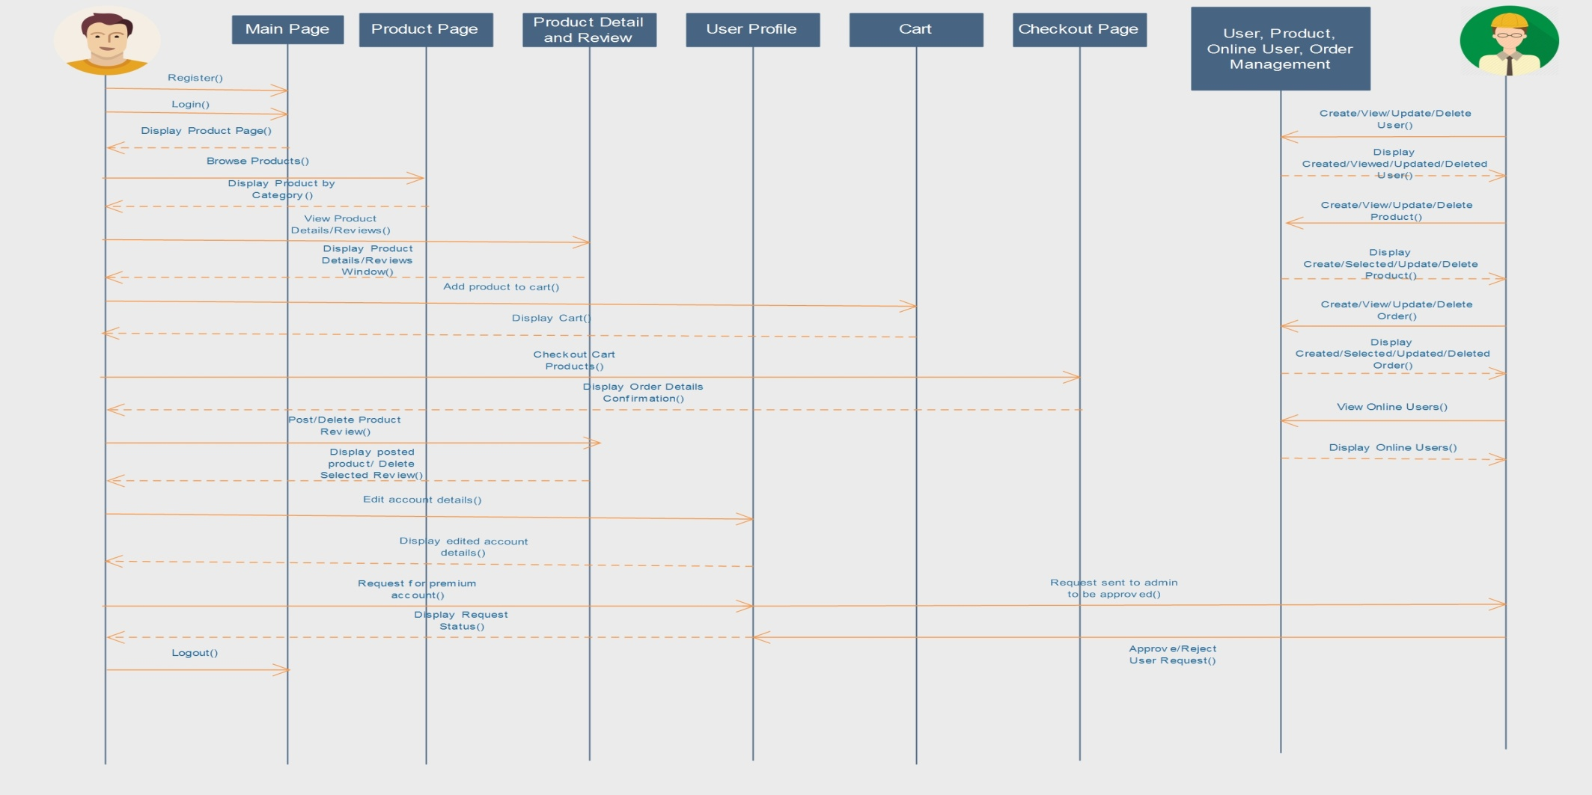
UML Diagram

Slide 17
Detailed Functions Per User
Customer
Register/Login/Logout
Browse products
Add to Cart
Edit cart
Remove product from cart
Add Product to favorite
Request for a premium account
View Product Details/Reviews
Post/Delete Product Reviews
Update account details
Admin
Start Admin Topic consumer
Approve/Reject Customer premium requests
Manage User, Admin, Orders (CRUD)
Check online users

Slide 18
Concepts Applied:
Filters/Listeners
Object Relational Mapping
JMS
REST
AJAX
JPQL
Password Hash
Spring Validator
ExtJS
GenericDAO
Cookies

